Slide 1



ELECTRON CONFIGURATION
the distribution of electrons of an atom or molecule (or other physical structure) in atomic or molecular orbitals
an energy is associated with each electron configuration
upon certain conditions, electrons are able to move from one orbital to another by emission or absorption of a quantum of energy, in the form of a electromagnetic wave (photon)

Slide 2
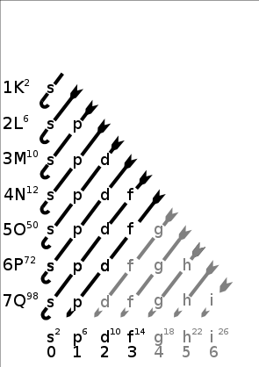
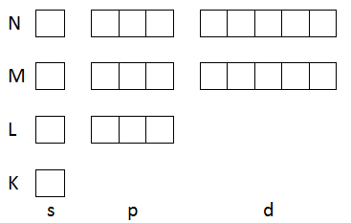
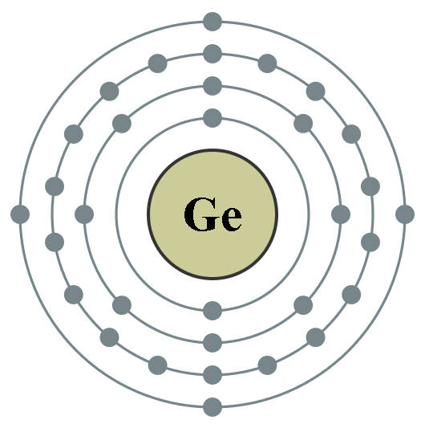
Electron configuration II
For example Germanium (32e⁻) has electron configuration 1s² 2s² 2p⁶ 3s² 3p⁶ 3d¹⁰ 4s² 2p²
Image shows the order of filling atomical orbitales for atoms

Slide 3
